Slide 1

Vehicle Tracking System
IN
Mining industries

Slide 2

Current Problems
Manual System
More man power involved
Pilferage of materials
Verification of tonnage & Trips
Lack of visibility of vehicle movements

Slide 3

Objective
Ensure Data authenticity
Ensure Data accuracy
Reduction of manual effort
Identify pilferage
Verify Tonnage & trips
Increased productivity

Slide 4
Proposed Solution
RFID tagging
Each vehicle carrying ore will be fixed with a RFID tag with unique identification number
All truck details including the registration number, model, owner details, driver details etc will be fed to the application software

Slide 5
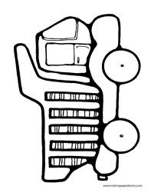
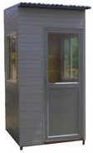
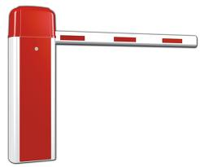
Proposed Solution
Security IN point
Empty trucks will first come to this point for entering inside mine
RFID reader fixed on gate will read the tag on truck
Application software verify the truck identity and opens boom barrier
Truck enters the mine

Slide 6
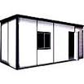
Proposed Solution
Tare Weight Point
Empty truck moves to the weighing balance for taking the tare weight
RFID reader at this point identifies the truck
Weight will be automatically transferred to the application software
Tare weight will be recorded in the application software for the truck

Slide 7

Proposed Solution
Loading point
  Truck will be loaded with the iron ore

Slide 8
Proposed Solution
Gross Weight Point
Loaded truck moves to the weighing balance for taking the gross weight
RFID reader at this point identifies the truck
Weight will be automatically transferred to the application software
Gross weight will be recorded in the application software for the truck
Net weight calculated by
deducting tare weight

Slide 9
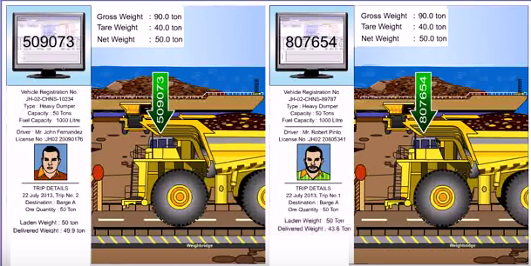
Proposed Solution
Gross Weight Point

Slide 10
Proposed Solution
Security OUT point
Loaded trucks will come to this point for going outside
RFID reader fixed on gate will read the tag on truck
Application software verify the truck identity and opens boom barrier
Truck leaves the mine

Slide 11
Proposed Solution
Destination Unloading Point
Loaded truck moves to the weighing balance for taking the gross weight
RFID reader at this point identifies the truck
Weight will be automatically transferred to the application software
Gross weight will be verified with the weight recorded at loading point

Slide 12
Proposed Solution
Pilferage Detection
If the difference between the gross weight recorded at the loading point and the gross weight recorded at the unloading point is negligible, the delivery is accepted
If the difference beyond the limit, it will be detected as pilferage and necessary alert/alarm will be generated

Slide 13
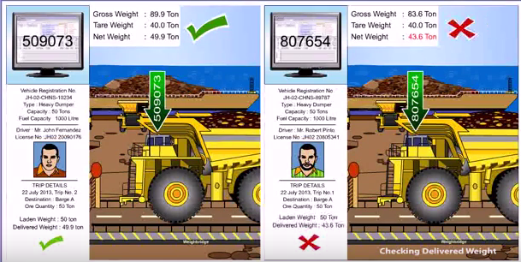
Proposed Solution
Pilferage Detection

Slide 14
Proposed Solution
Logging Trip completion
When the gross weight verification completes at the unloading point, trip completion receipt will be issued to the driver
Driver can collect payment for the trip with this receipt

Slide 15
Proposed Solution
Prevent Multiple Trip Logging
If driver take the truck again to another weighing balance without unloading the material, it will be detected as duplicate trip logging
Necessary alarm/alert will be generated and trip completion receipt will not be issued

Slide 16
STALLION SYSTEMS AND SOLUTIONS PVT LTD.
Stallion House, Padam Stop, KP Vallon Road
Kadavanthra, Kochi, 682020
www.stallionindia.com
Email : sales@stallionindia.com
Thank You !

